Slide 1


VERB Tense
ERROR

Slide 2
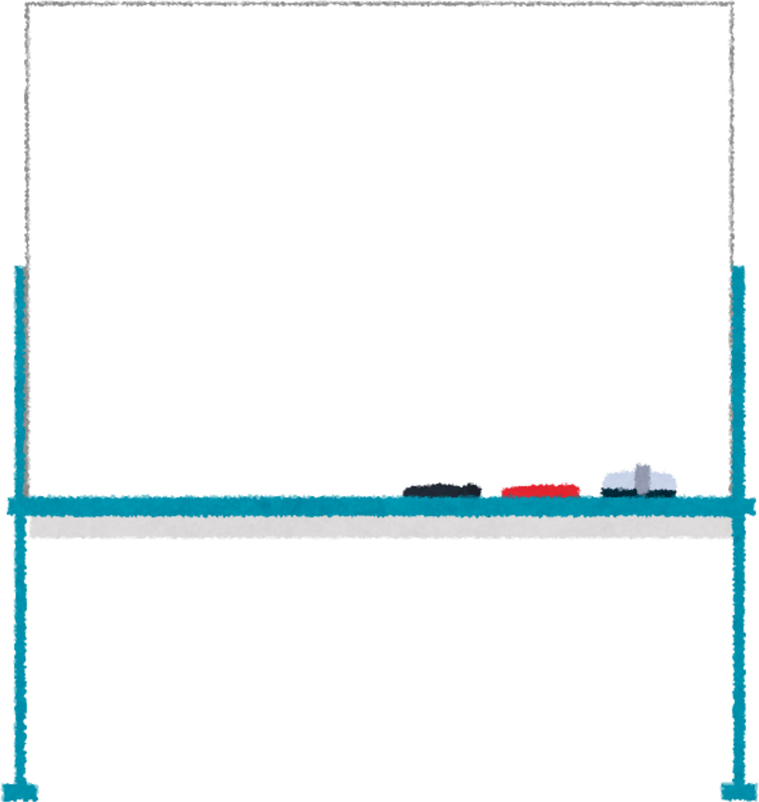

what is verb tense error?
A verb tense error occurs when the verb used in a sentence does not match the appropriate tense for the intended meaning.
often leads to confusion or miscommunication;
can occur accidentally

Slide 3
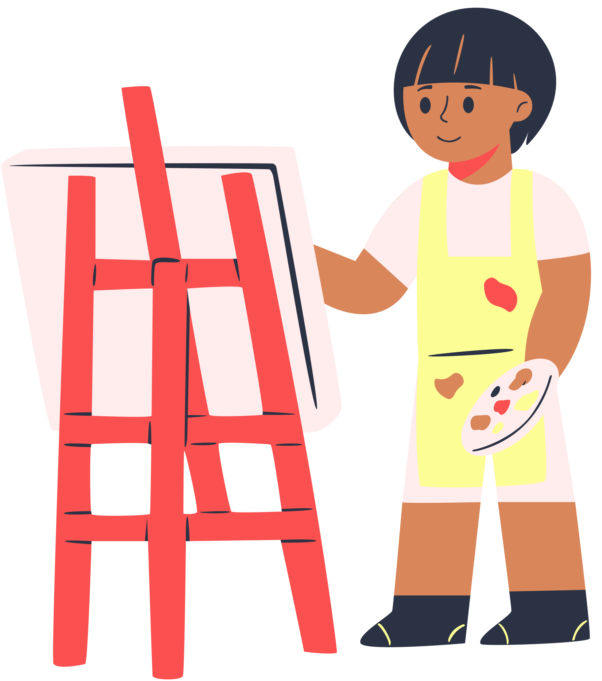
To make our writing or speaking understandable and clear, it is essential to use the correct verb tense

Slide 4

types of Verb tense errors
VERB TENSE ERRORS
VERB FORM ERRORS
VERB MOOD ERRORS
VERB VOICE
ERRORS

Slide 5
what’s wrong with this sentence?
I am going to the beach yesterday.

Slide 6
I am going to the beach yesterday.
CORRECTION:
I went to the beach yesterday.
went = past tense = yesterday
am going = present tense

Slide 7
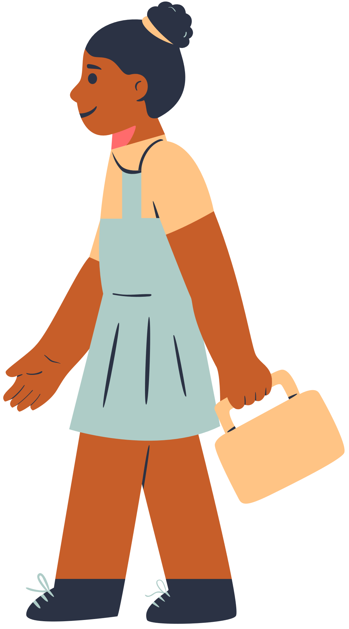
A verb tense error occurs when the verb used in a sentence does not match the appropriate tense for the intended meaning.

Slide 8
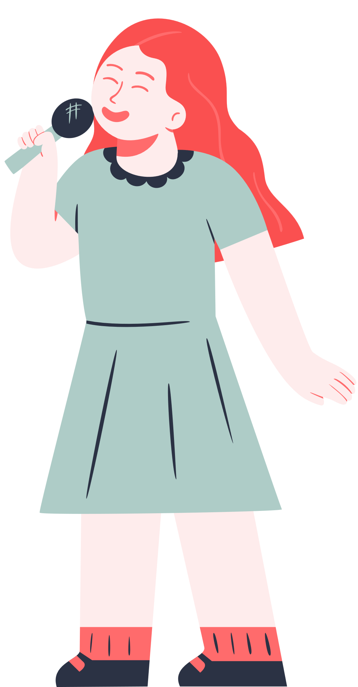
what’s wrong with this sentence?
She have a good time at the party.

Slide 9
She have a good time at the party.
CORRECTION:
She had a good time at the party.
Have = base form
had = past tense

Slide 10
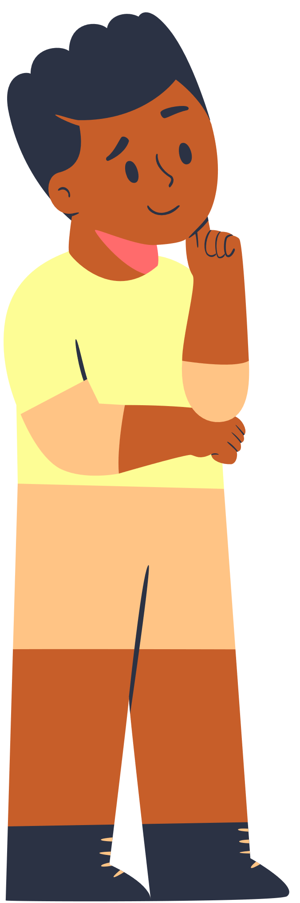
A verb form error occurs when the wrong form of the verb is used, such as using the base form instead of the past tense.

Slide 11
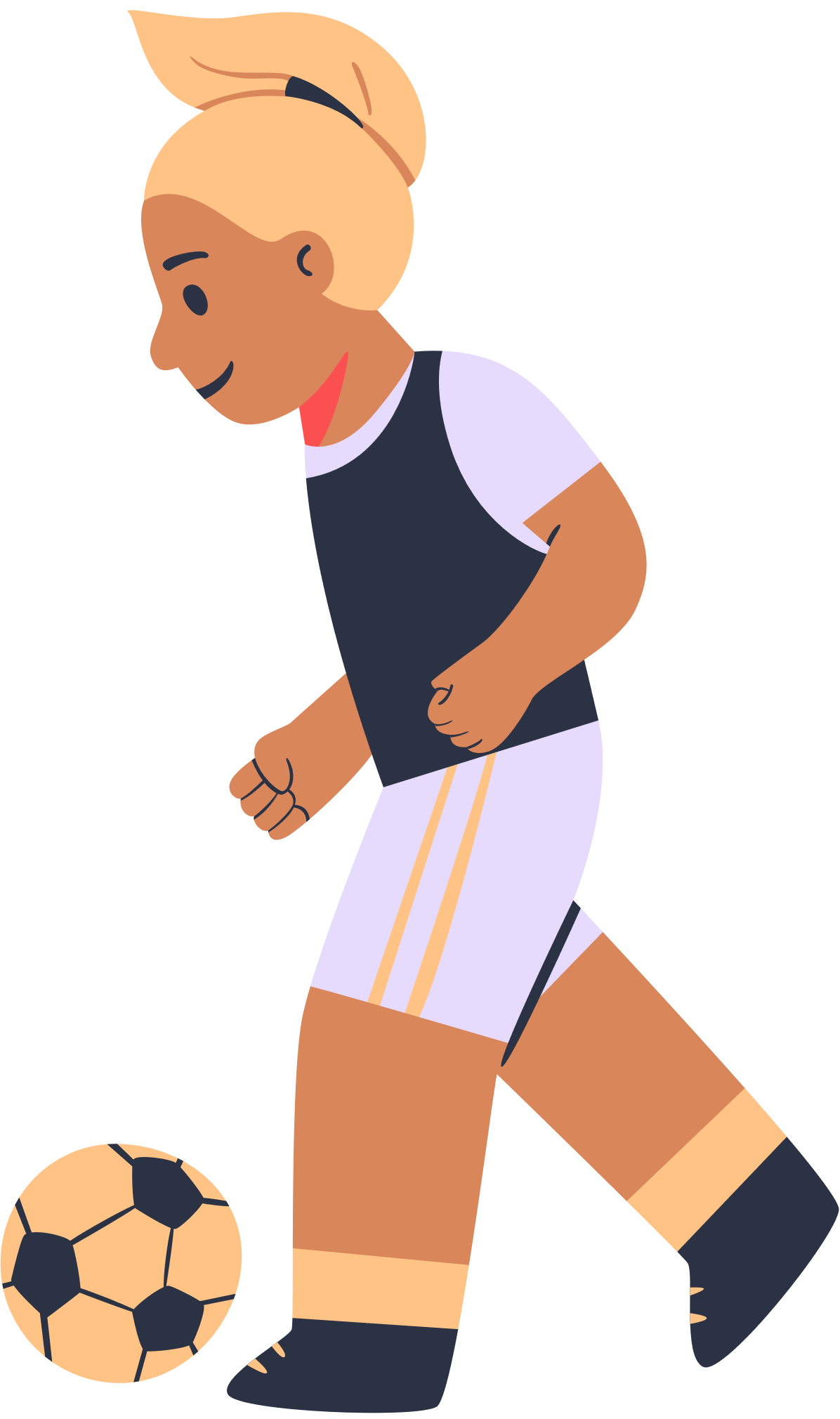
what’s wrong with this sentence?
If I was you, I will do it differently.

Slide 12
If I was you, I will do it differently.
CORRECTION:
If I were you, I would do it differently.
was = indicative
were = subjunctive

Slide 13
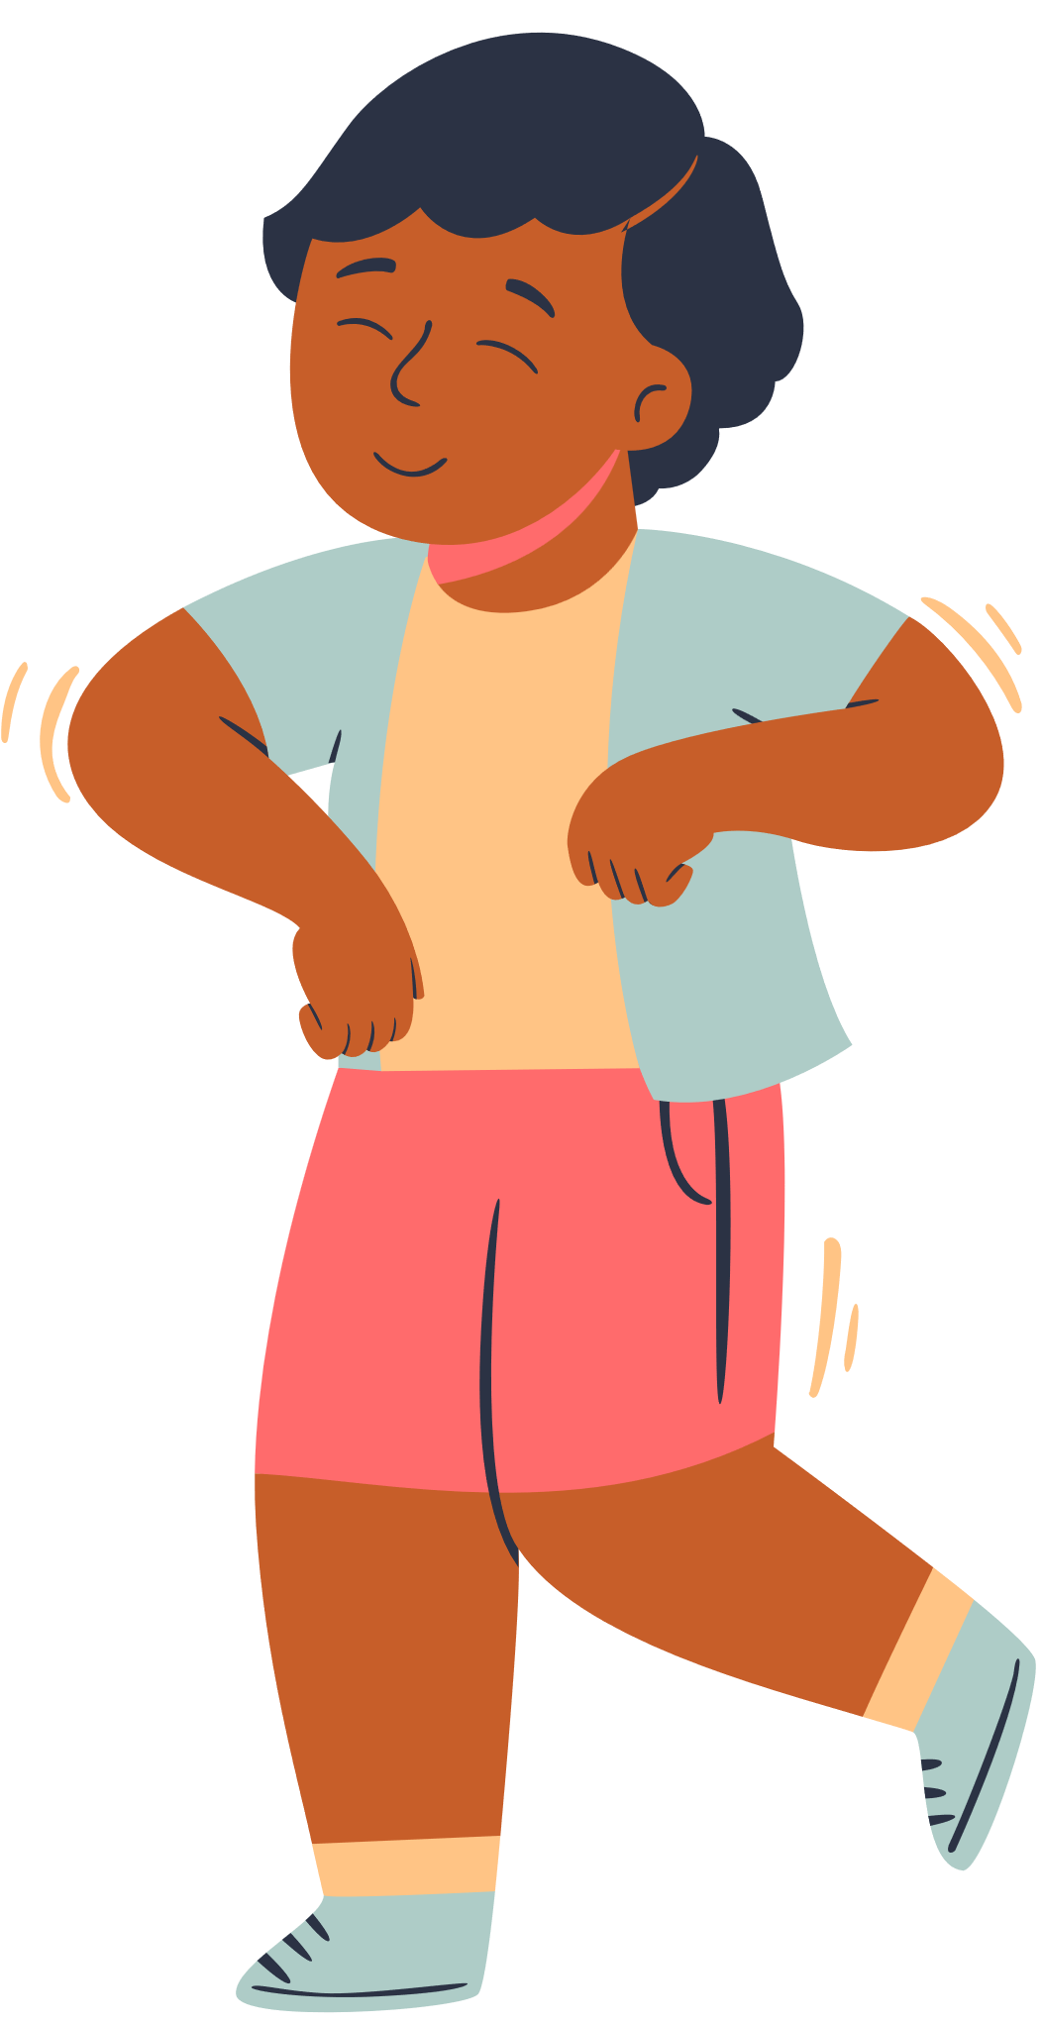
A verb mood error happens when the wrong mood of the verb is used, like using the indicative mood instead of the subjunctive mood.

Slide 14
VERB MOODS
INDICATIVE
used for stating facts or opinions.
I believe he is right.
Subjunctive
used for hypothetical situations, wishes, or suggestions.
I wish I were there.
Imperative
used for giving commands or instructions.
Please pass the salt.

Slide 15
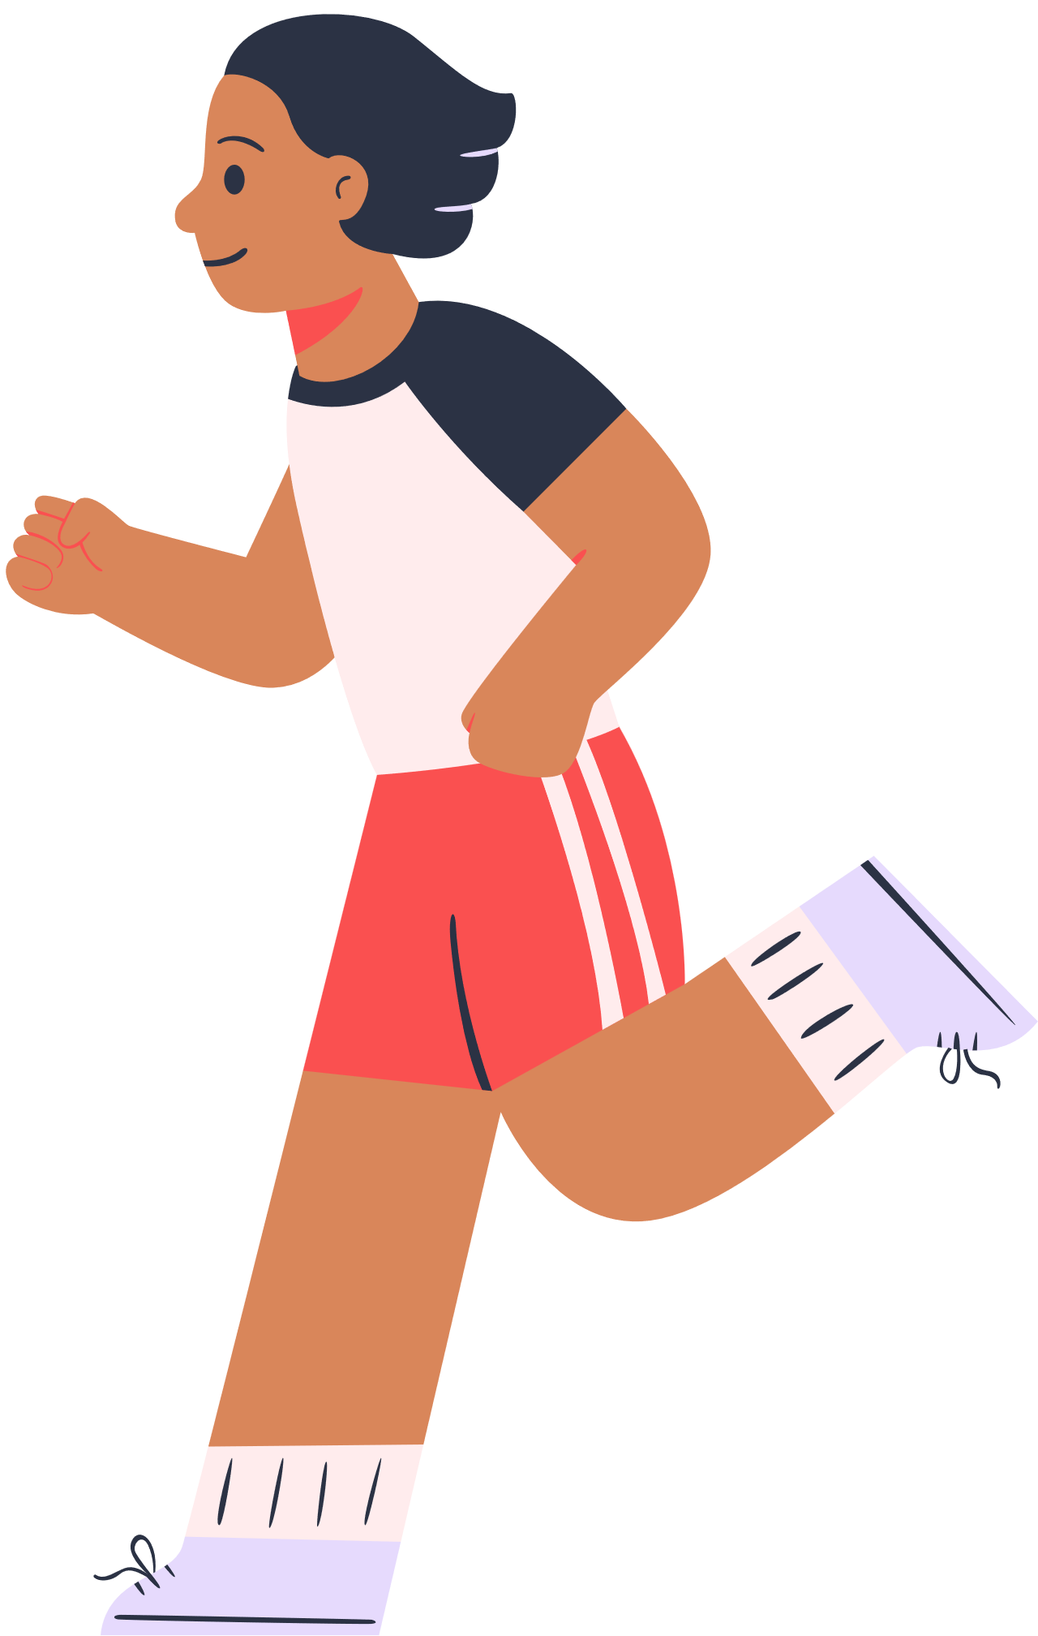
what’s wrong with this sentence?
The book was written by Mark Twain.

Slide 16
The book was written by Mark Twain.
CORRECTION:
Mark Twain wrote the book.
was written = passive voice
wrote = active voice

Slide 17
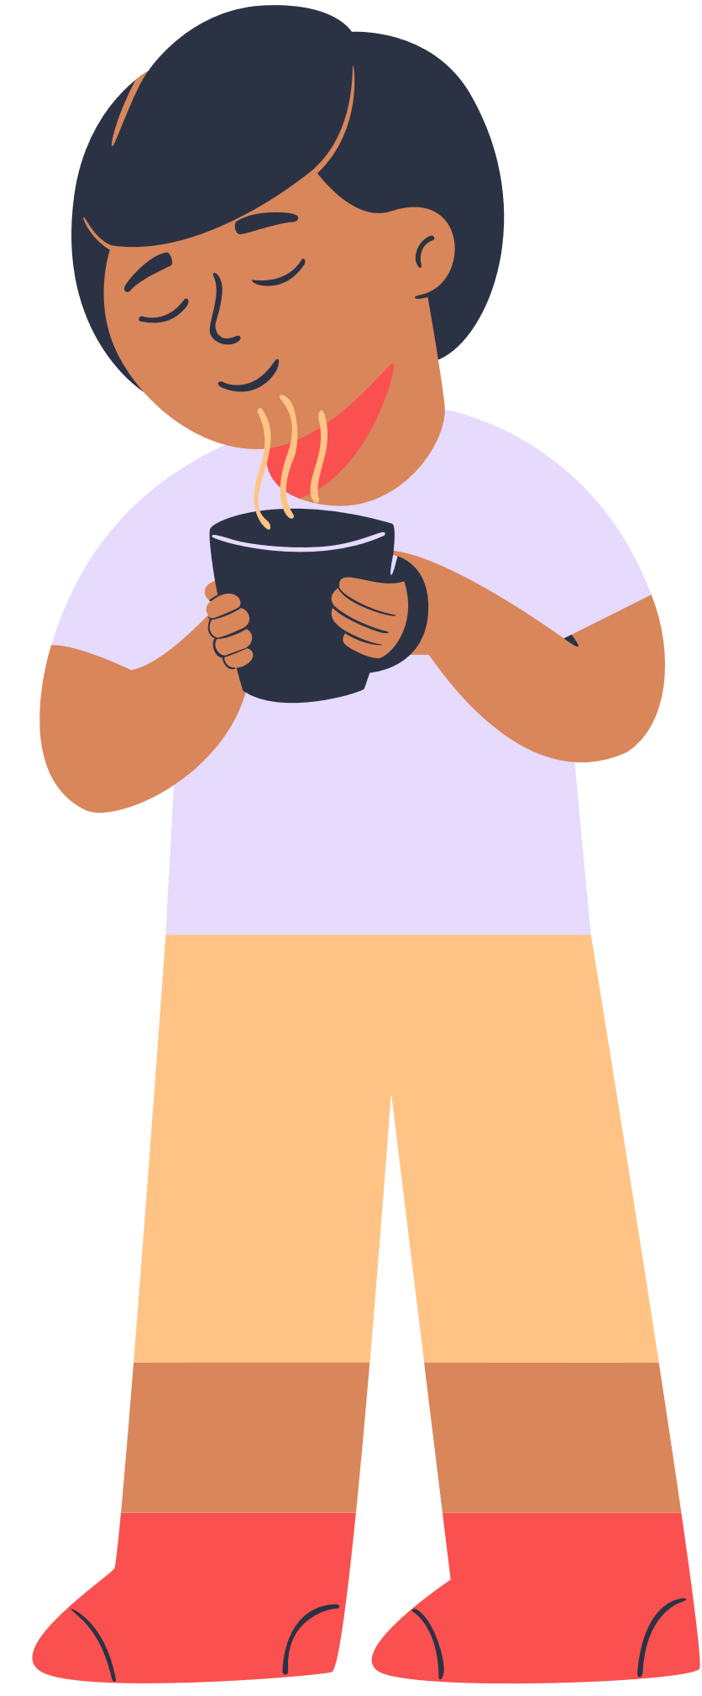
A verb voice error occurs when the wrong voice of the verb is used, such as using the passive voice instead of the active voice WHICH INHIBITS CLEAR AND DIRECT COMMUNICATION.

Slide 18

let’s
practice

Slide 19

1. The company ___________ a new marketing campaign next week.
a) will launch
b) launch
c) launches
d) launching

Slide 20
1. The company ___________ a new marketing campaign next week.
a) will launch
b) launch
c) launches
d) launching

Slide 21
2. The children ___________ in the park when it started raining.
a) plays
b) play
c) were playing
d) played

Slide 22
2. The children ___________ in the park when it started raining.
a) plays
b) play
c) were playing
d) played

Slide 23

3. She ________ her phone on the table yesterday.
a) put
b) puts
c) putting
d) had put

Slide 24
3. She ________ her phone on the table yesterday.
a) put
b) puts
c) putting
d) had put

Slide 25
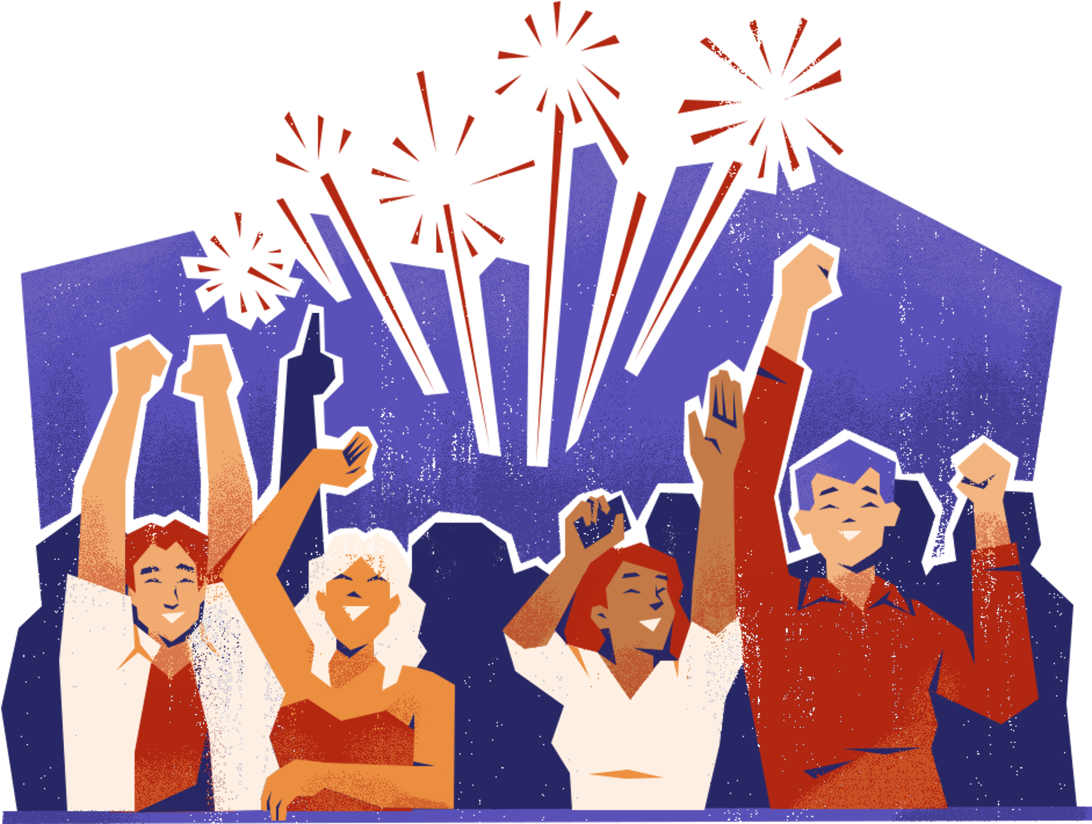
4. My brother and I ___________ going to the concert tonight.
a) is
b) are
c) am
d) be

Slide 26
4. My brother and I ___________ going to the concert tonight.
a) is
b) are
c) am
d) be

Slide 27

5. Choose the sentence with the correct verb form:
a) She have been working all day.
b) She has been working all day.
c) She have been worked all day.
d) She has been work all day.

Slide 28
5. Choose the sentence with the correct verb form:
a) She have been working all day.
b) She has been working all day.
c) She have been worked all day.
d) She has been work all day.

Slide 29
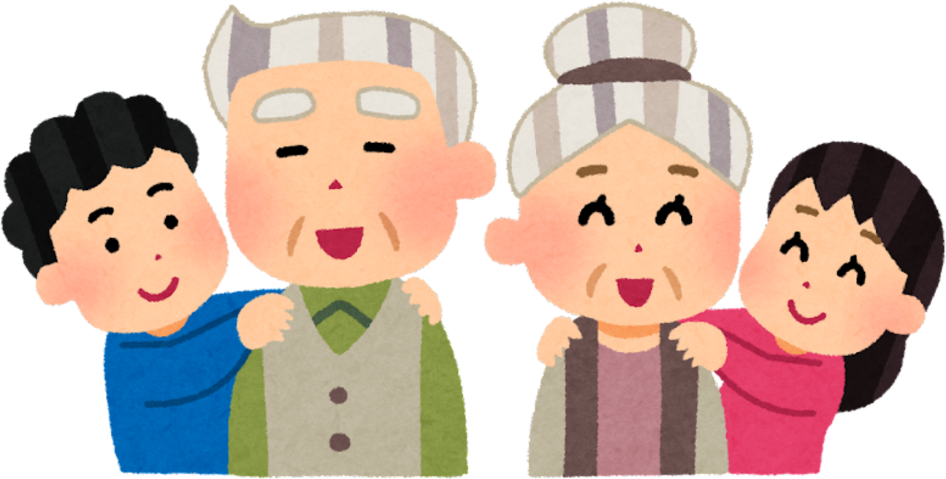
6. I will visit my grandparents next weekend. They ________________ very excited to see me.
a) is
b) are
c) were
d) will be

Slide 30
6. I will visit my grandparents next weekend. They ________________ very excited to see me.
a) is
b) are
c) were
d) will be

Slide 31

7. Yesterday, I ________________ my favorite book and couldn't put it down.
a) read
b) reads
c) have read
d) will read

Slide 32
7. Yesterday, I ________________ my favorite book and couldn't put it down.
a) read
b) reads
c) have read
d) will read

Slide 33
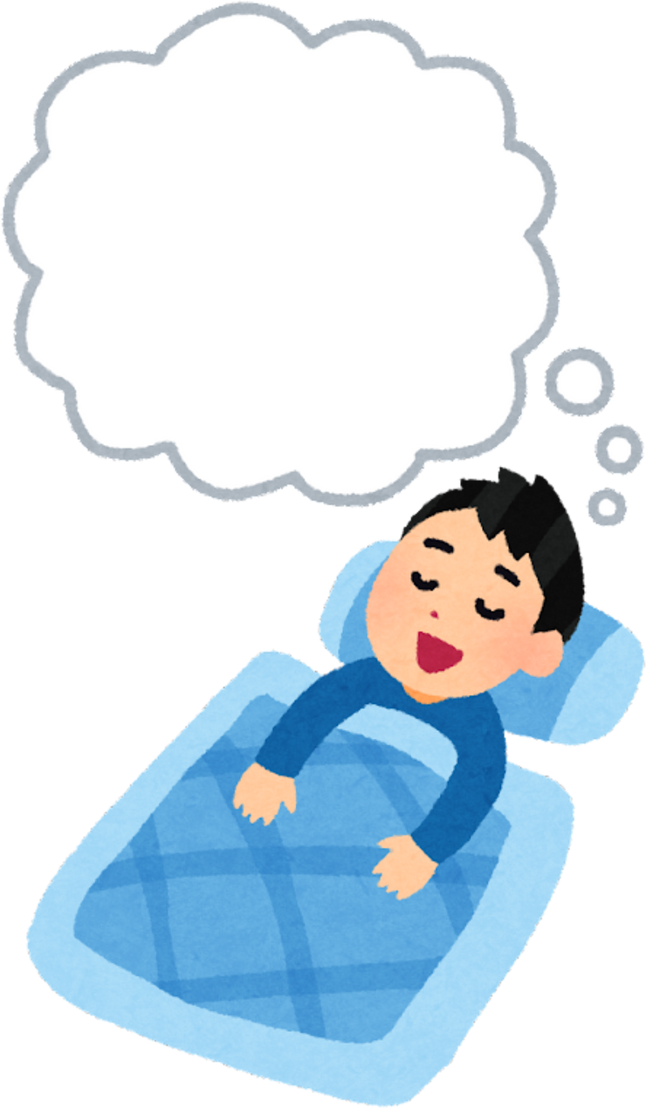
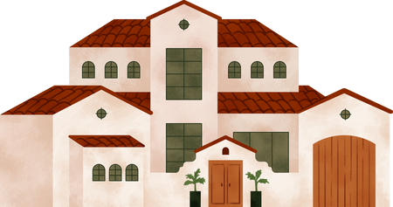
8. If I _____ you, I would buy a big house.
a) is
b) are
c) was
d) were

Slide 34
8. If I _____ you, I would buy a big house.
a) is
b) are
c) was
d) were

Slide 35

9. I ________ to the store to buy some groceries.
a) gone
b) goes
c) going
d) went

Slide 36
9. I ________ to the store to buy some groceries.
a) gone
b) goes
c) going
d) went

Slide 37
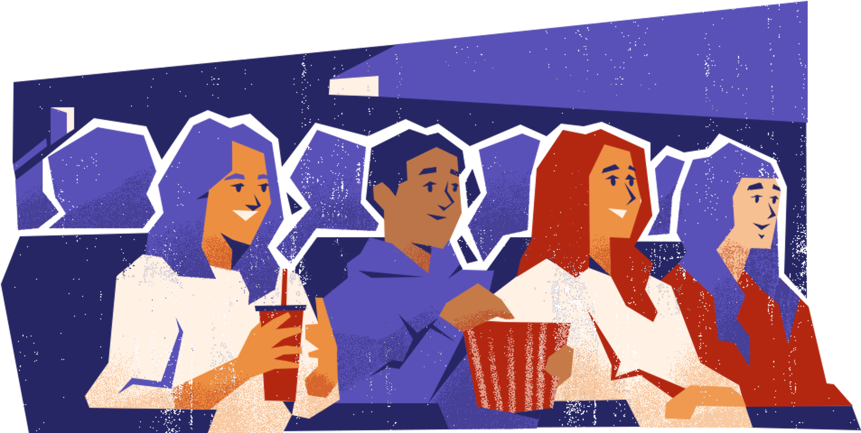
10. They ________ the movie last night.
a) watch
b) watches
c) watching
d) watched

Slide 38
10. They ________ the movie last night.
a) watch
b) watches
c) watching
d) watched

Slide 39
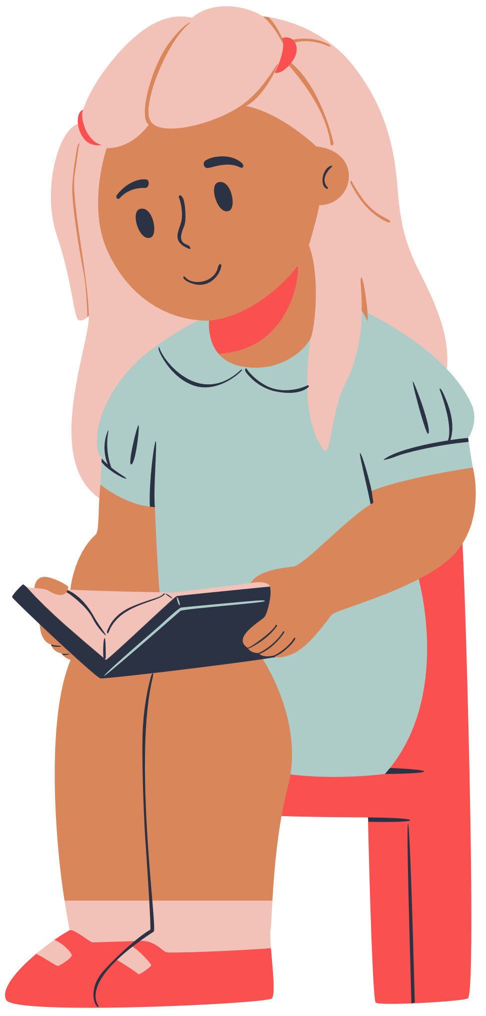
Thank you for listening!

